Slide 1
COVID- 19 Analysis & Prediction Master of Data Science
Lecturer: Dr. Saw Shier Nee
Group Name: Ctrl + Alt + Analyze
Members: 1. Choon Yue Hua
2. Duan Xuanrui
3. Nur Hidayah binti Ahmad Shafii
4. Then Dao Qing
5. Yang Dandan

Slide 2
Business Understanding
Phase 1

Slide 3


Business backgound：
COVID-19 is caused by the novel coronavirus SARS- CoV-2, where it spreads from person through close contacts, spreading rapidly and internationally.
In this case, scientists began to work on a vaccine. The vaccine received regulatory approval and production was rapidly scaled up to meet global demand. A global vaccination campaign has been launched to vaccinate eligible people against COVID-19.

Slide 4
Business backgound：
Since the end of the pandemic, while there has not been a huge surge in disease cases, COVID-19 continues to pose a significant risk to society due to the mutation of the virus and vaccine coverage, and disparities in healthcare systems.
For example, in Brazil, as per data from the Ministry of Health, from January to September 2023, the unfortunate toll of COVID-19 claimed the lives of over 12,000 individuals from about 1.5 million reported cases.
Given the complex challenges posed by COVID-19's evolving landscape, there is a need to continue to seek solutions that address key aspects. The effectiveness of vaccination and the constant changes associated with virus variants all pose potential dangers.

Slide 5
Objectives:
1. To identify the vaccinations progress across different countries and globally.
2. To analyze the confirmed and death cases across different countries and globally.
3. To determine the combination of vaccines used in each country.
4. To develop machine learning model to forecast the total vaccination, confirmed and death cases.
Assumption: ​
The data is accurate, reliable, latest and covers a wide range of countries.

Slide 6
Data Mining Goal
Visualization of Total Vaccinations: Perform a thorough analysis of the dataset to gain insights into the distributions, trends, and correlations among variables related to vaccination rates, vaccine types, and geographical factors.
Vaccine Combination Analysis: Investigate the combination of vaccines used in each country to understand vaccination strategies, prediction and vaccine distribution patterns.
Prediction of total vaccination, confirmed cases & death: To train and validate the regression & time series model using vaccination data, ensuring robustness and accuracy in predicting total vaccination numbers.

Slide 7
Project Plan
Collection
Cleaning
Modelling
Evaluation
Visualization
Deployment

Slide 8
Data Understanding
Phase 2

Slide 9
Phase 2: Data Understanding
Data source:
https://www.kaggle.com/datasets/gpreda/covid-world-vaccination-progress/data
https://www.kaggle.com/datasets/josephassaker/covid19-global-dataset/data
Data Range: December 2020 - March 2022
country_vaccinations | country_vaccinations_by_manufacture | worldometer_coronavirus_daily_data | worldometer_coronavirus_summary_data
Total rows: 86512 Total columns: 15 | Total rows: 35623 Total columns: 4 | Total rows: 184787 Total columns: 7 | Total rows: 226 Total column: 12

Slide 10
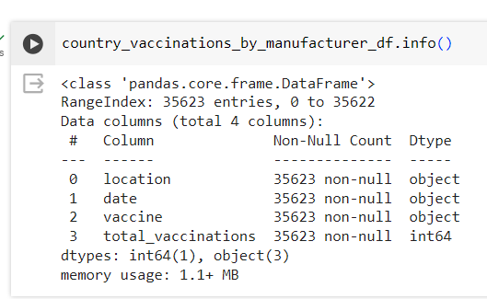
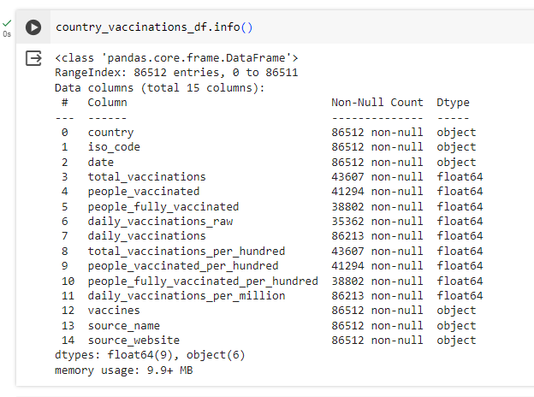
Phase 2: Data Understanding
Variable:

Slide 11
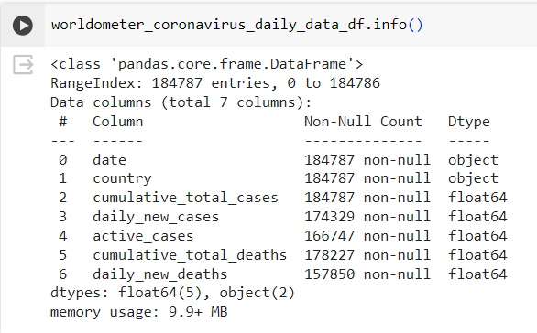
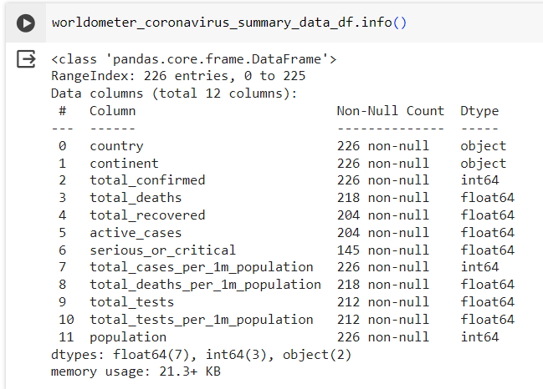
Phase 2: Data Understanding
Variable:

Slide 12
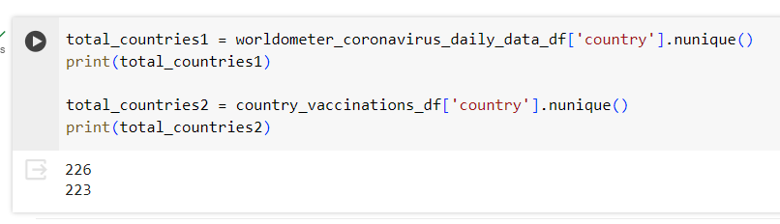
Phase 2: Data Understanding
Country:

Slide 13
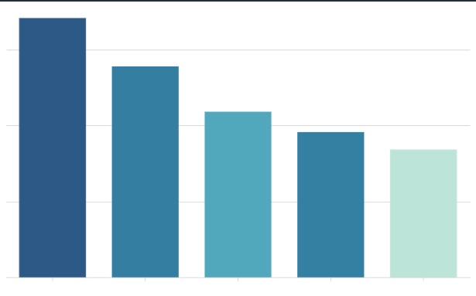
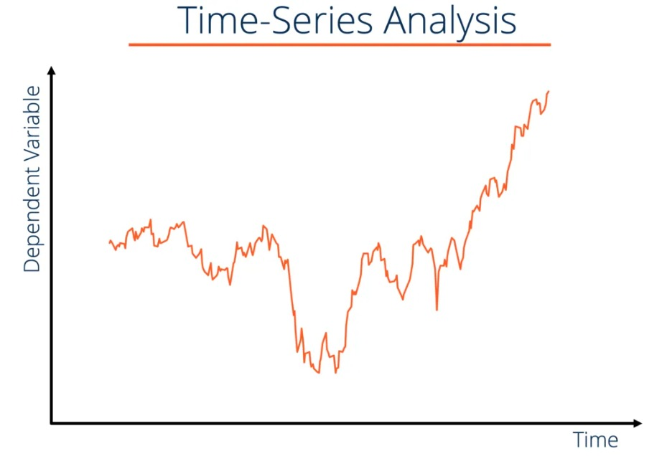
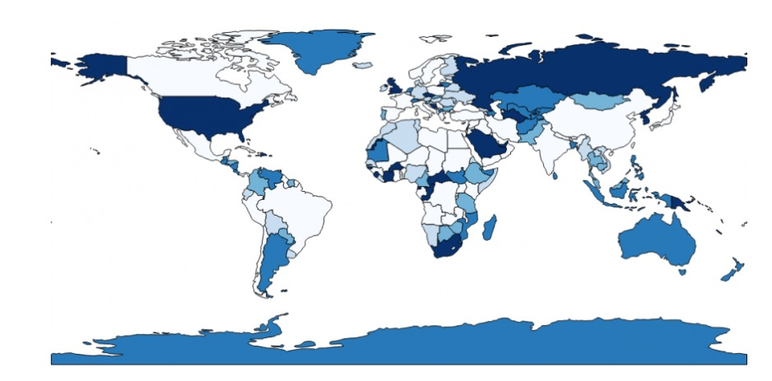
Data Exploratory:
Visualization of Vaccination Data by Country: This includes the use of bar charts
Time Series Analysis: This method tracks changes over time, providing insights into trends over specific intervals.
Choropleth Graphs: Choropleth graphs provide a geographical visualization, highlighting variations across different regions in a visually impactful manner.

Slide 14
Data Preparation
Phase 3

Slide 15
Phase 3: Data Preparation – Select Data
Country Vaccination Data:
Data Given | Date Excluded | Data Included
Country (223) ISO code Date Total vaccinations People vaccinated People fully vaccinated Daily vaccinations raw Total vaccinations per hundred People vaccinated per hundred People fully vaccinated per hundred Daily vaccinations per million Vaccines Source name Source website | ISO code Source name Source website Daily vaccination raw | Country Date Total vaccinations People vaccinated Total vaccinations per hundred People vaccinated per hundred People fully vaccinated People fully vaccinated per hundred Daily vaccinations per million Vaccines

Slide 16
Phase 3: Data Preparation – Select Data
Coronavirus Daily Data:
Data Given | Date Excluded | Data Included
Country Date Cumulative total cases Daily new cases Active cases Cumulative total death Daily new death | Daily new cases Active cases Daily new death | Country Date Cumulative total cases Cumulative total death

Slide 17
Phase 3: Data Preparation – Select Data
Coronavirus Summary Data:
Data Given | Date Excluded | Data Included
Country Continent Total confirmed Total death Total recovered Active cases Serious or critical Total cases per 1M population Total deaths per 1M population Total test Total test per 1M population Population | Continent Serious or critical Total cases per 1M population Total deaths per 1M population Total test Total test per 1M population Population | Total confirmed Total death Total recovered Active cases Population

Slide 18
Phase 3: Data Preparation
Clean Data
Look into the missing value.
- NaN values fill in with zero.
2. Remove redundant information from the data
- Remove England, Scotland, Wales and Northern Ireland from data because United Kingdom is union of the countries.
- Standardized the country name used in data sets
'Czechia' == "Czech Republic
'United Kingdom' == "UK"
'United States' == "USA"
'Northern Cyprus' == "Cyprus"
3. Identify the outliers

Slide 19
Phase 3: Data Preparation
Construct Data
Create new attributes – percentage vaccinated by dividing people vaccinated by population
Integrate Data
Combine different datasets on common key - country
Format Data
Ensure that data type in each column is correct using pandas DataFrames
Format date to datetime format

Slide 20
Modelling
Phase 4

Slide 21
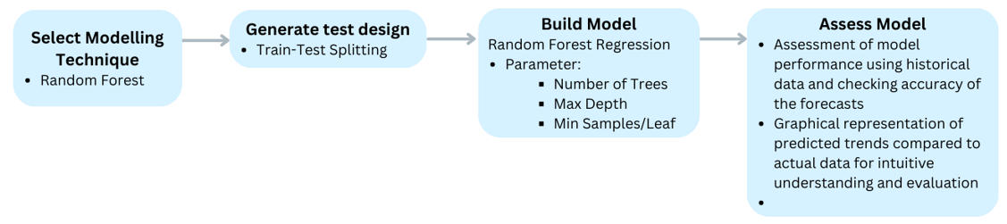
Phase 4: Modelling
To predict total vaccination:

Slide 22
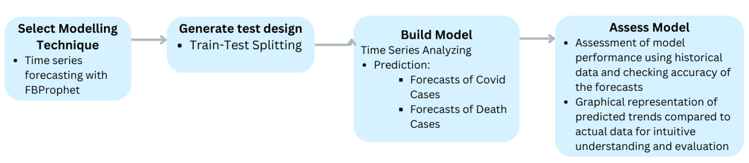
Phase 4: Modelling
To predict confirmed Covid cases and death cases:

Slide 23
Evaluation
Phase 5

Slide 24
Phase 5: Evaluation
Relevance to Objectives
Evaluate the accuracy and reliability of the data sources, ensure that the analysis produces credible and trustworthy results that can be used for decision-making.
Comprehensiveness and Depth
Assess the comprehensiveness and depth of the analysis in covering relevant aspects of Covid-19 vaccination, such as vaccination rates, coverage, distribution, effectiveness, and impact.
Stakeholder Engagement
Consider the extent to which stakeholders are engaged in the analysis process and whether their perspectives, needs, and feedback are incorporated into the analysis.

Slide 25
Phase 5: Evaluation
Test
Metrics
We established a partition ratio of 70% for training and 30% for testing
We selected five metrics to analyze: accuracy, precision, recall, F1-Score, and AUC

Slide 26
Deployment
Phase 6

Slide 27
Phase 6: Deployment
Summary Key Insights
A brief summary of key insights from vaccination data reporting, including vaccination coverage, vaccination disparities and emerging trends in vaccine-preventable diseases
Review the Results
Review the results of the vaccination data assessment to identify key insights that can guide vaccination strategies, target high-risk populations, and optimise vaccine distribution plans
Develop a Deployment Strategy
Develop a strategy to incorporate data mining insights into the public health decision-making process

Slide 28
Thanks!
Do you have any questions?

